Slide 1
Discrete decision making
Lecture 2. Performance metrics and classification models

Slide 2
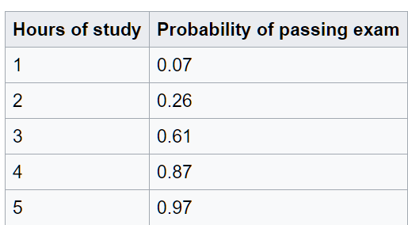
Implementation problem
Different packages generate different result:
Input:
Output:
Poisson (stats model)
1 0.90
2 0.80
3 0.72
4 0.64
5 0.57
Sklearn
logit
1 0.32
2 0.46
3 0.61
4 0.75
5 0.84
Stats models
logit
1 0.55
2 0.61
3 0.66
4 0.71
5 0.75
Wiki:

Slide 3
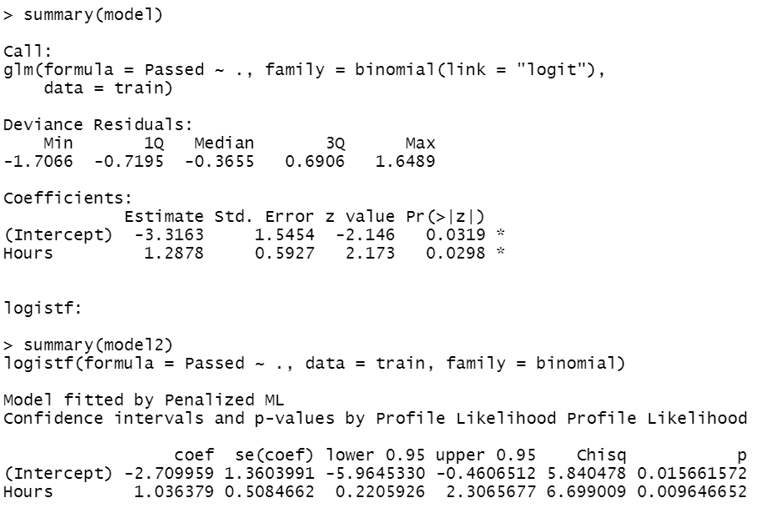
R language results
GLM
[1] 0.1162429 [1] 0.3228511 [1] 0.6334625 [1] 0.8623444 [1] 0.9578194
Logit
[1] 0.1579475 [1] 0.3458795 [1] 0.5984901 [1] 0.8077657 [1] 0.9221509
GLM Generalized linear model

Slide 4
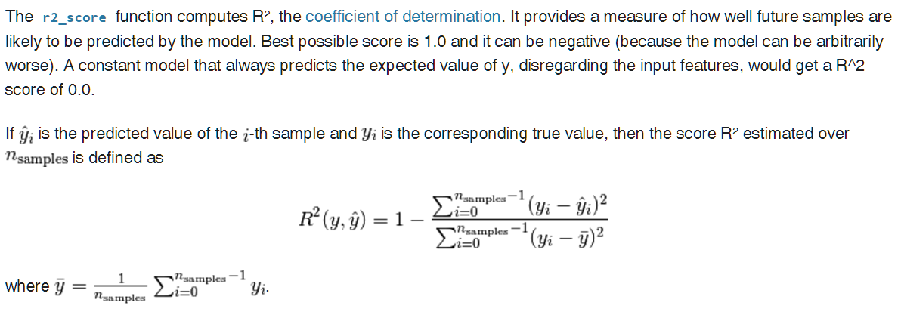
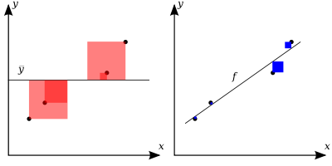
Coefficient of determination
The better the linear regression (on the right) fits the data in comparison to the simple average (on the left graph), the closer the value of R2 is to 1. The areas of the blue squares represent the squared residuals with respect to the linear regression. The areas of the red squares represent the squared residuals with respect to the average value.

Slide 5
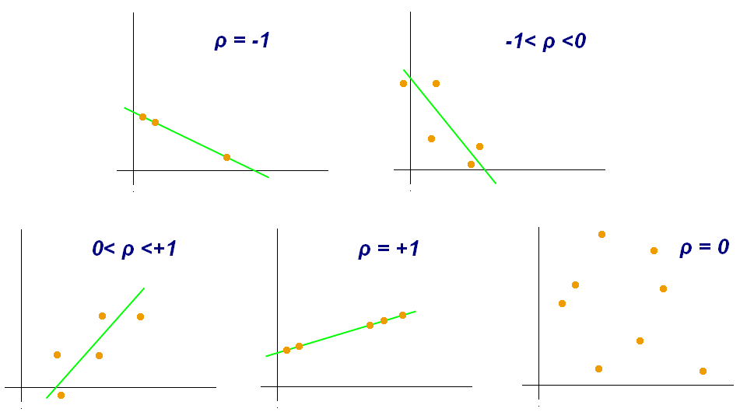
Correlation
Pearson correlation coefficient, also referred to as the Pearson's r or Pearson product moment correlation coefficient (PPMCC), is a measure of the linear dependence between two variables X and Y. It has a value between +1 and −1 inclusive, where 1 is total positive linear correlation, 0 is no linear correlation, and −1 is total negative linear correlation. It is widely used in the sciences.

Slide 6
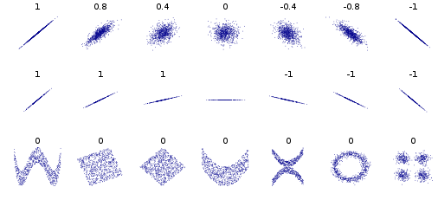
Examples

Slide 7
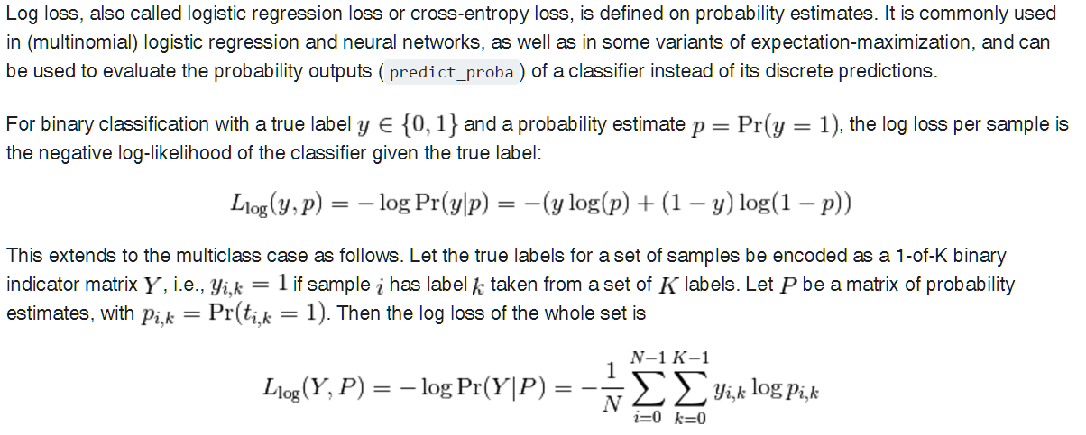
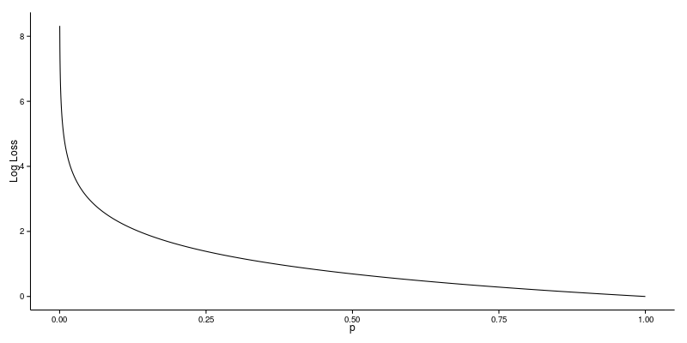
Log loss metrics

Slide 8
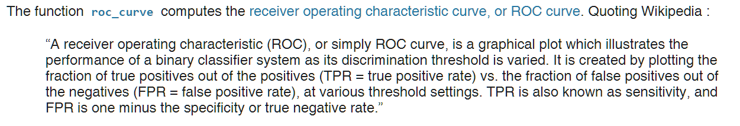
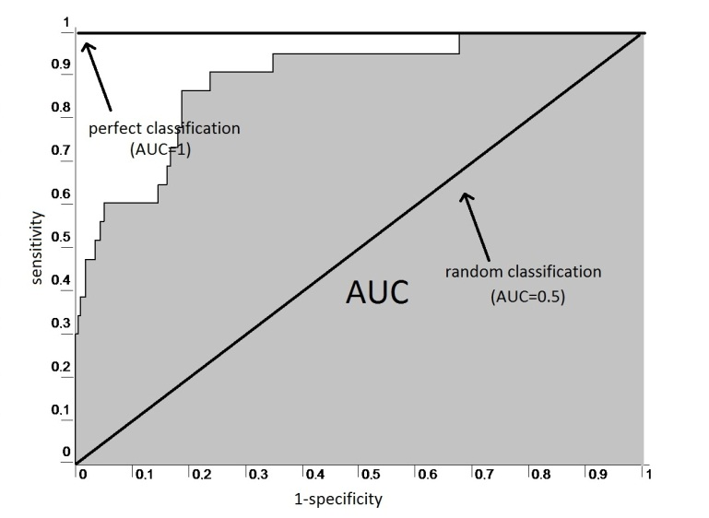
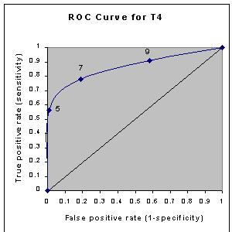
Receiver operating characteristic (ROC)

Slide 9
Example: Perfect vs Random
Perfect:
Log loss value: 9.99200722163e 16
R^2 score: 1.0
Roc Auc score: 1.0
Correlation: 1.0
Random:
Log loss value: 1.29857000091
R^2 score: 0.830739623517
Roc Auc score: 0.31
Correlation: 0.346888982345

Slide 10
Example: Probability of passing an exam versus hours of study
Sklearn
logit
Log loss value sklearn1: 0.489980678791
R^2 score sklearn1: 0.366725249226
Roc Auc score: 0.895
Correlation: 0.689183273573
Stats models
logit
Log loss value stats models logit: 0.639808424311
R^2 score stats models logit: 0.0942382042652
Roc Auc score: 0.895
Correlation: 0.690025483257
Poisson (stats model)
Log loss value Poisson: 1.15030944937
R^2 score Poisson: 0.621746536178
Roc Auc score: 0.105
Correlation: 0.689645936835

Slide 11
What to do?
Try other procedures
Find better parameters for existing procedures
3. Try other approaches

Slide 12
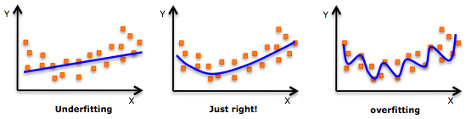
Problem of overfitting
In statistics and machine learning, one of the most common tasks is to fit a "model" to a set of training data, so as to be able to make reliable predictions on general untrained data. In overfitting, a statistical model describes random error or noise instead of the underlying relationship. Overfitting occurs when a model is excessively complex, such as having too many parameters relative to the number of observations. A model that has been overfit has poor predictive performance, as it overreacts to minor fluctuations in the training data.

Slide 13
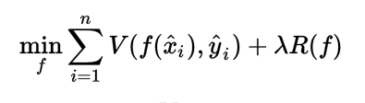
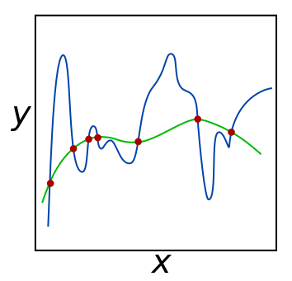
Regularization
Regularization, in mathematics and statistics and particularly in the fields of machine learning and inverse problems, refers to a process of introducing additional information in order to solve an ill posed problem or to prevent overfitting.
The green and blue functions both incur zero loss on the given data points. A learned model can be induced to prefer the green function, which may generalize better to more points drawn from the underlying unknown distribution, by adjusting L, the weight of the regularization term.

Slide 14
The inverse of regularization strength in logistic regression
sklearn.linear_model.LogisticRegression
C : float, optional (default=1.0) Inverse of regularization strength; must be a positive float. Like in support vector machines, smaller values specify stronger regularization.
Let’s try C = 1e5

Slide 15
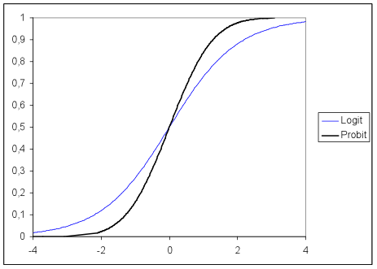
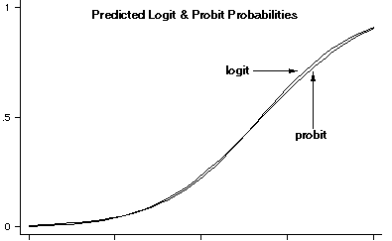
Probit model
In statistics, a probit model is a type of regression where the dependent variable can only take two values, for example married or not married. The word is a portmanteau, coming from probability + unit. The purpose of the model is to estimate the probability that an observation with particular characteristics will fall into a specific one of the categories; moreover, if estimated probabilities greater than 1/2 are treated as classifying an observation into a predicted category, the probit model is a type of binary classification model.

Slide 16
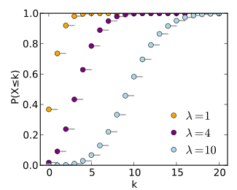
Poisson regression
In statistics, Poisson regression is a generalized linear model form of regression analysis used to model count data and contingency tables. Poisson regression assumes the response variable Y has a Poisson distribution, and assumes the logarithm of its expected value can be modeled by a linear combination of unknown parameters. A Poisson regression model is sometimes known as a log-linear model, especially when used to model contingency tables.
The horizontal axis is the index k, the number of occurrences. The CDF is discontinuous at the integers of k and flat everywhere else because a variable that is Poisson distributed takes on only integer values.

Slide 17
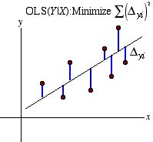
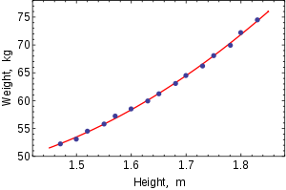
Ordinary least squares
In statistics, ordinary least squares (OLS) or linear least squares is a method for estimating the unknown parameters in a linear regression model, with the goal of minimizing the sum of the squares of the differences between the observed responses (values of the variable being predicted) in the given dataset and those predicted by a linear function of a set of explanatory variables. Visually this is seen as the sum of the squared vertical distances between each data point in the set and the corresponding point on the regression line – the smaller the differences, the better the model fits the data. The resulting estimator can be expressed by a simple formula, especially in the case of a single regressor on the right-hand side.

Slide 18
Check results
Log loss value sklearn2 (logit with regularization): 0.40149392338
R^2 score sklearn2: 0.453266281637
Roc Auc score: 0.895
Correlation: 0.673817051076
Log loss value stats models Probit: 0.638694066151
R^2 score stats models probit: 0.0953266812562
Roc Auc score: 0.895
Correlation: 0.690012505523
Log loss value Poisson: 1.15030944937
R^2 score Poisson: -0.621746536178
Roc Auc score: 0.105
Correlation: -0.689645936835
Log loss value OLS: 0.419932480932
R^2 score OLS: 0.454453887315
Roc Auc score: 0.895
Correlation: 0.689243146278

Slide 19
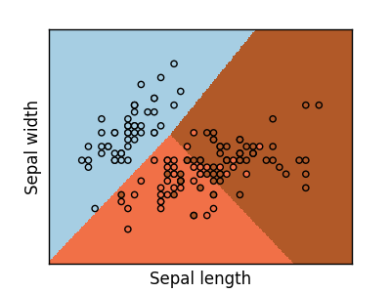
Classification with logit model
http://scikit-learn.org/stable/auto_examples/linear_model/plot_iris_logistic.html#sphx-glr-auto-examples-linear-model-plot-iris-logistic-py
The Iris flower data set or Fisher's Iris data set is a multivariate data set introduced by Ronald Fisher in his 1936 paper The use of multiple measurements in taxonomic problems as an example of linear discriminant analysis. It is sometimes called Anderson's Iris data set because Edgar Anderson collected the data to quantify the morphologic variation of Iris flowers of three related species

Slide 20
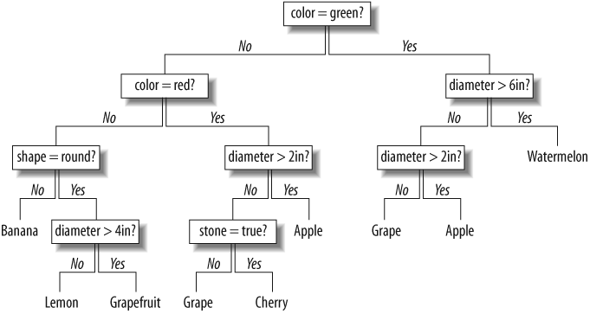
Decision trees
A decision tree is a decision support tool that uses a tree-like graph or model of decisions and their possible consequences, including chance event outcomes, resource costs, and utility. It is one way to display an algorithm.

Slide 21
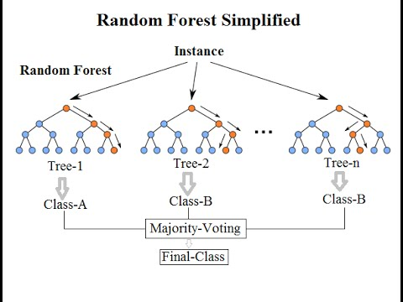
Random forest
Random forests or random decision forests are an ensemble learning method for classification, regression and other tasks, that operate by constructing a multitude of decision trees at training time and outputting the class that is the mode of the classes (classification) or mean prediction (regression) of the individual trees. Random decision forests correct for decision trees' habit of overfitting to their training set

Slide 22
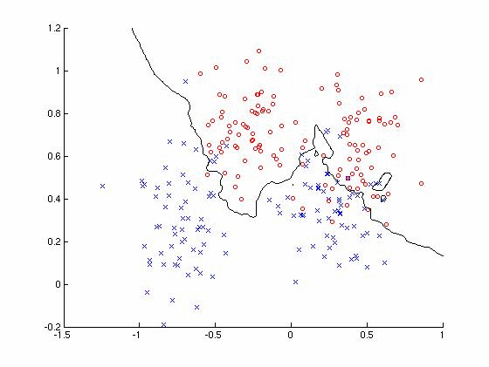
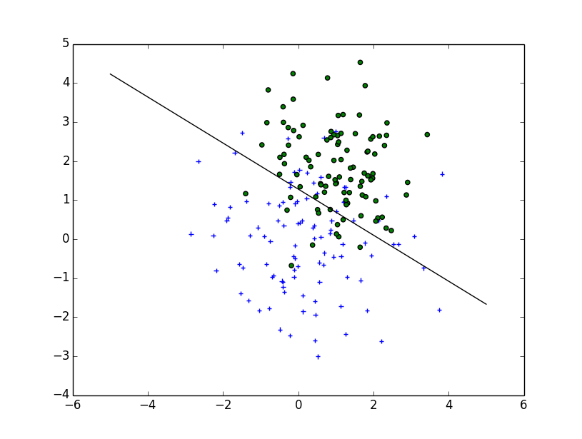
k-nearest neighbors
In pattern recognition, the k-nearest neighbors algorithm (k-NN) is a non-parametric method used for classification and regression. In both cases, the input consists of the k closest training examples in the feature space. The output depends on whether k-NN is used for classification or regression:

Slide 23
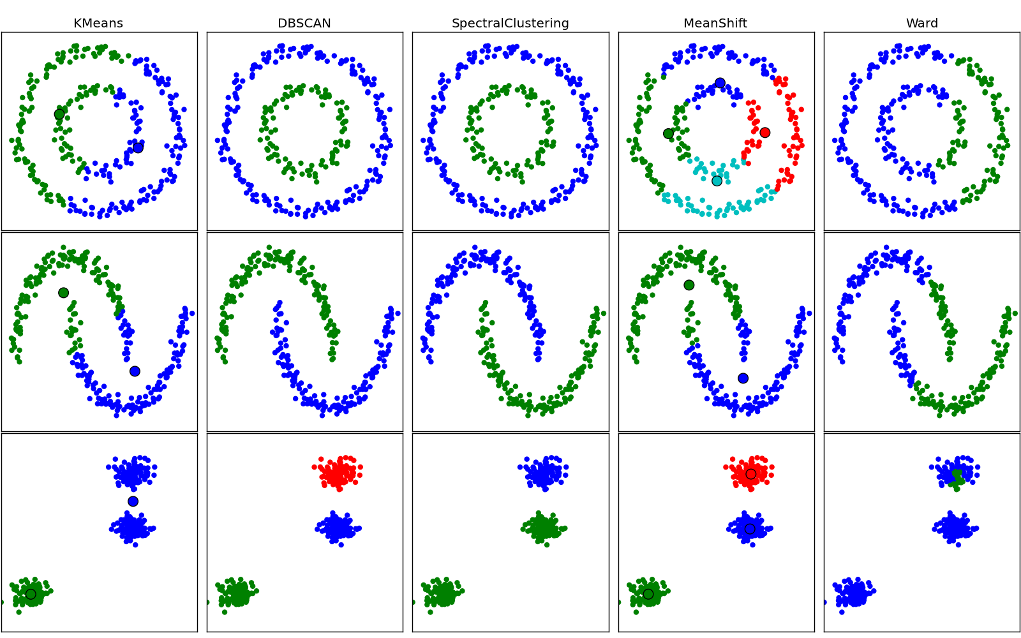
Classifier comparison

Slide 24
Check results
RandomForest
R^2 score RandomForest: 0.8
Roc Auc score: 0.95
Matthews corrcoef 0.904534033733
AdaBoost
R^2 score AdaBoost: 0.8
Roc Auc score: 0.95
Matthews corrcoef 0.904534033733
KNeighbors
R^2 score KNeighbors: 0.2
Roc Auc score: 0.8
Matthews corrcoef 0.612372435696
DecisionTree
R^2 score DecisionTree: 0.8
Roc Auc score: 0.95
Matthews corrcoef 0.904534033733

